Slide 1
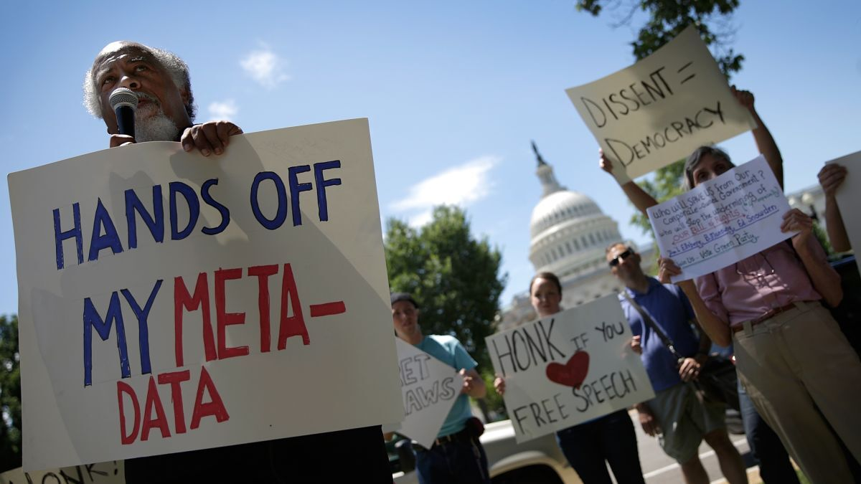
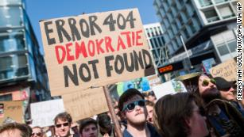
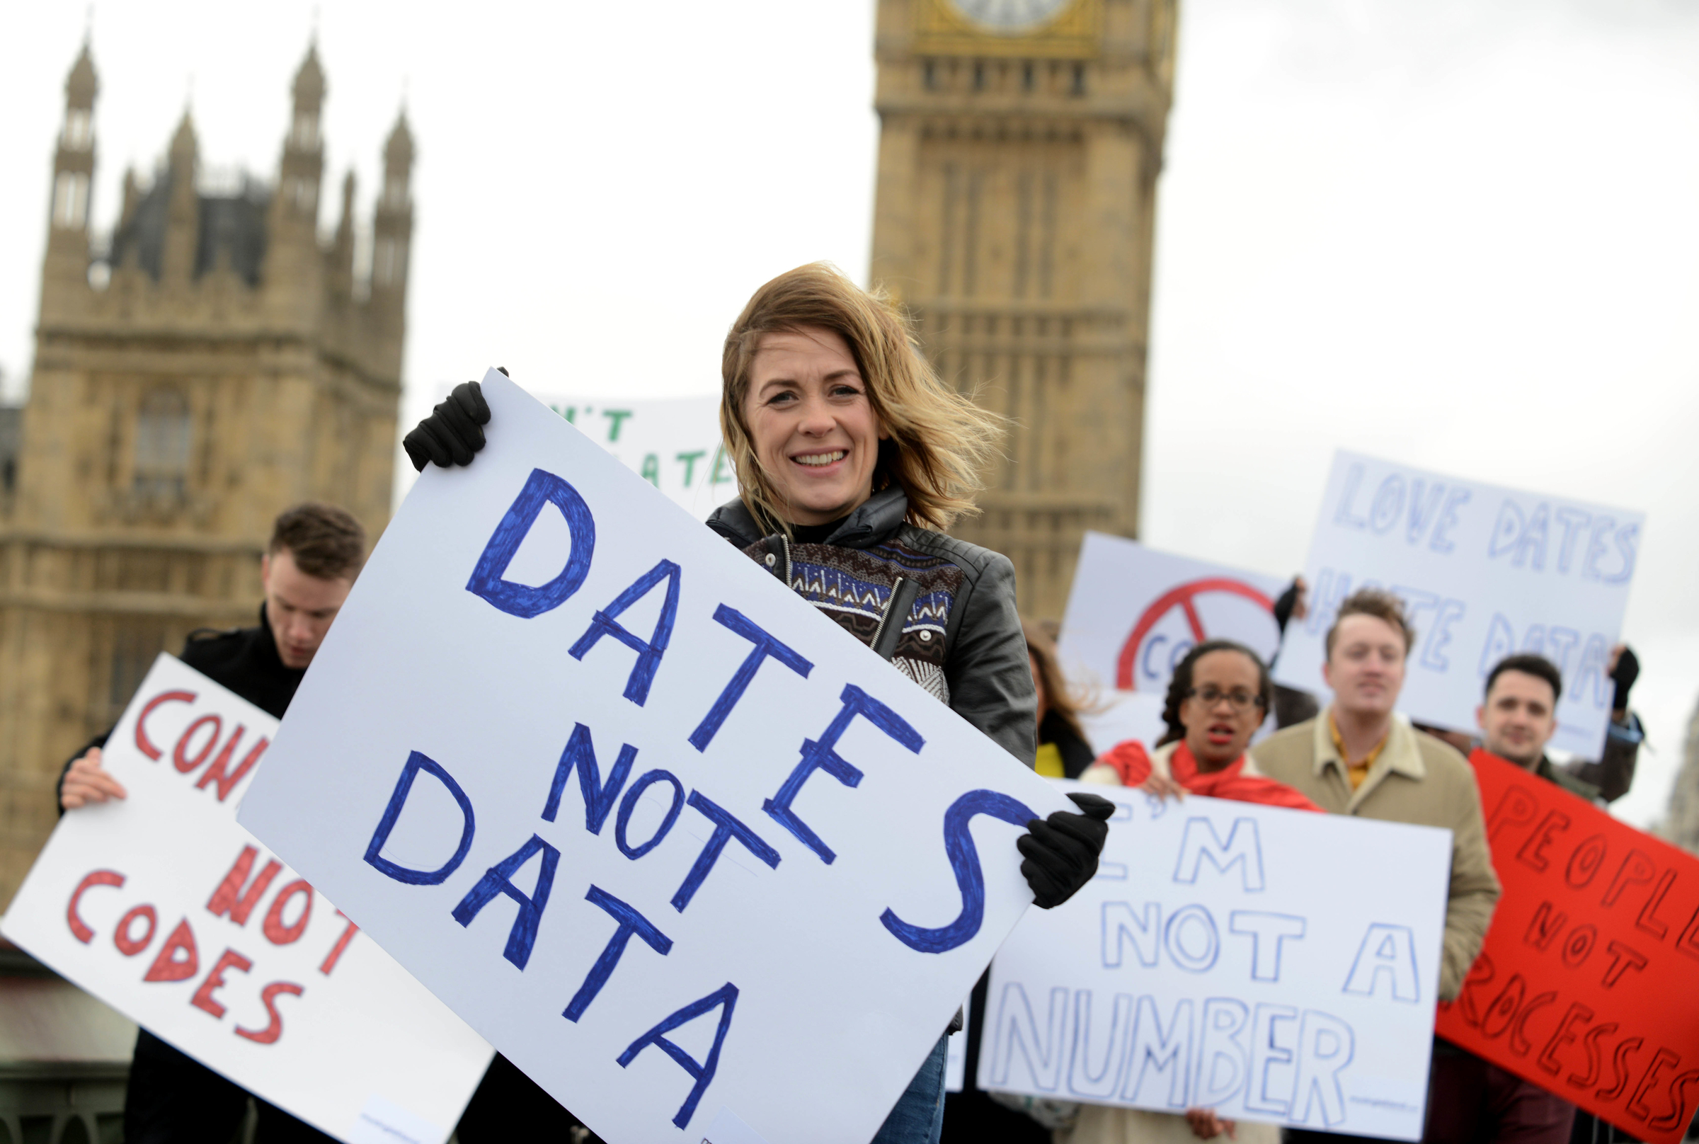

TEAM ABRACA-DATA
Fereshteh Aghaei, Jen Mahon,
Julia Squeri, John Shuford
Protests for Happiness: an analysis of relationships between protest behavior and country happiness as measured by the World Happiness Report
Notes:
Julia

Slide 2
Overview and Hypothesis An analysis of protest activity from 2015 to 2019 in Europe, Asia and South America in comparison to various metrics of happiness in these regions
Hypotheses:
There will be regional differences in protest size, amount of protests to occur, and the reason behind protests.
If there are a large amount of protests in a country, then the country will have lower happiness and freedom scores.
Analysis Questions:
Protest Count: How many total protests occurred per region? How does this differ between the regions and countries?
Protest Size: How many people attended the protests per region?
Protest Reason: What were the protest reasons? How does this differ between the regions?
Happiness Score: Do the number/frequency of protests in a country affect how happy the country is?
Freedom Score: Does a country's freedom score correlate with the amount of protests occurring?
Notes:
Julia

Slide 3
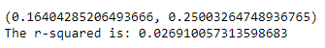
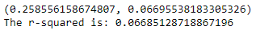
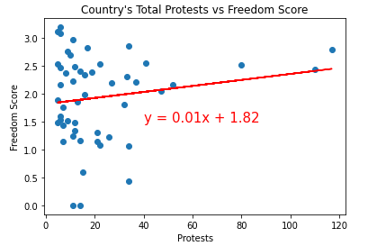
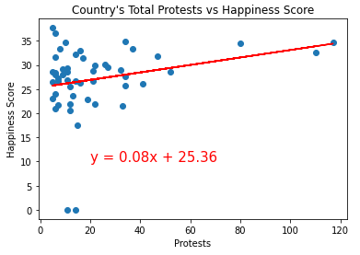
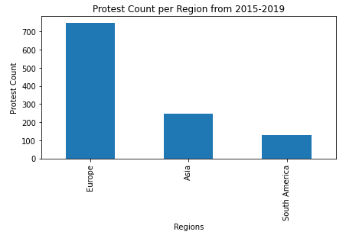
Brief Summary Of Findings
We found support for our first hypothesis but no statistical correlation for our second
Notes:
Julia

Slide 4
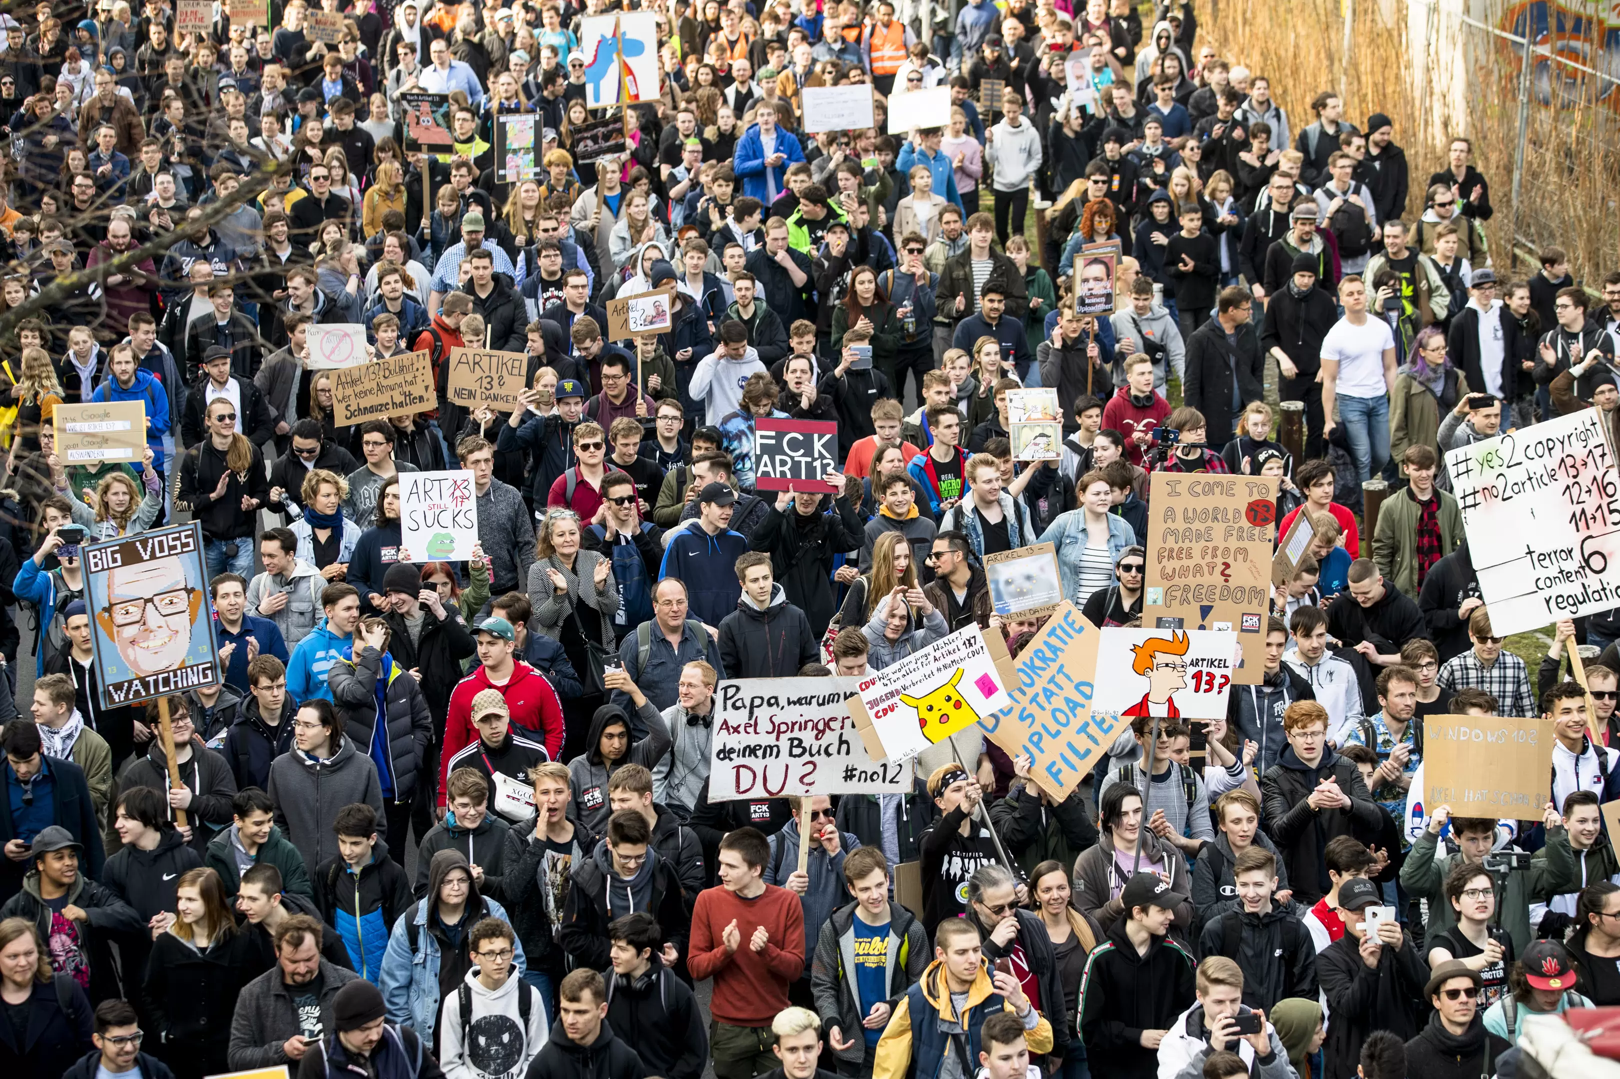
Protest analysis
Sourced from Mass Mobilization Protest Data – Harvard Dataverse
https://dataverse.harvard.edu/dataset.xhtml?persistentId=doi:10.7910/DVN/HTTWYL
Pulled csv file of data and cleaned:
Looked for years 2015-2019
Pulled only Europe, Asia & South America for regions
Cleaned data to rid it of trailing zeros
Only pulled countries with 5 or more protests
Notes:
John

Slide 5
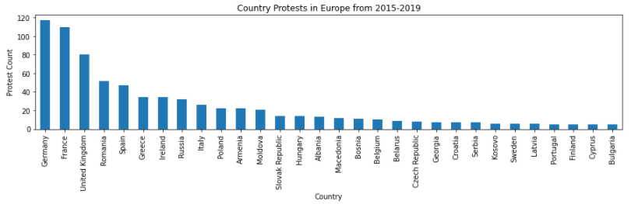
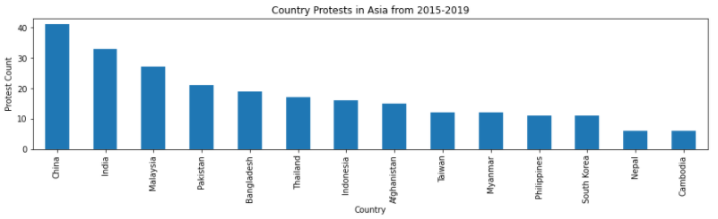
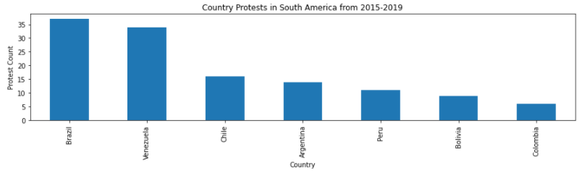
Protest analysis Protest Count: How many total protests occurred per region? How does this differ between the regions and countries?
Notes:
John

Slide 6
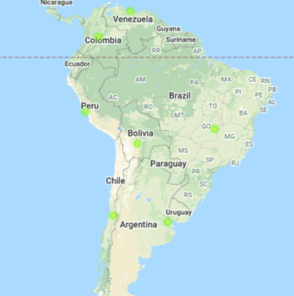
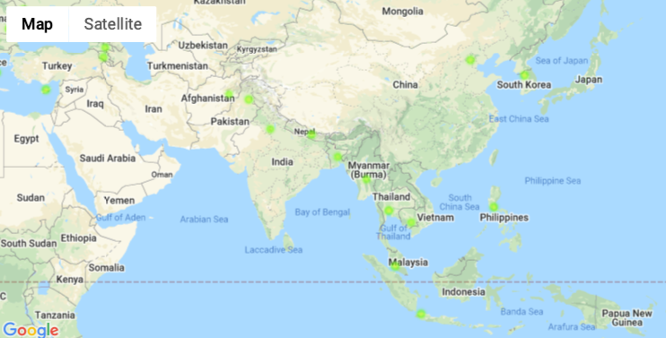
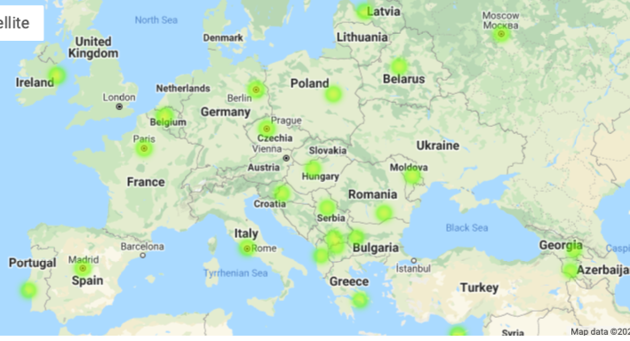
Protest analysis
Notes:
John

Slide 7
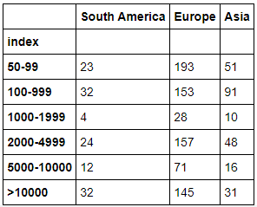
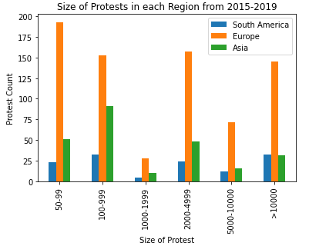
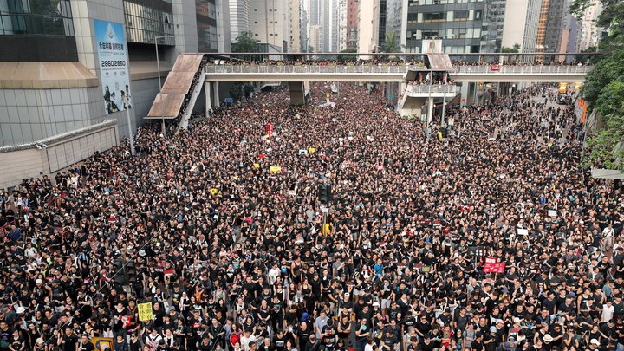
Protest analysis Protest Size: How many people attended the protests per region?
Notes:
John

Slide 8
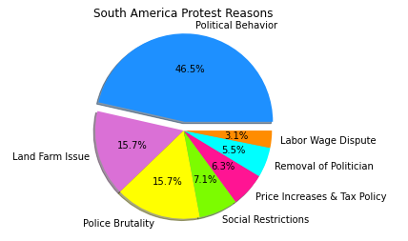
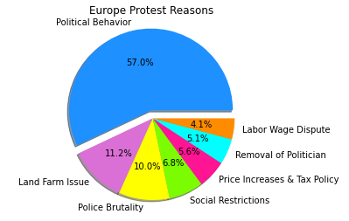
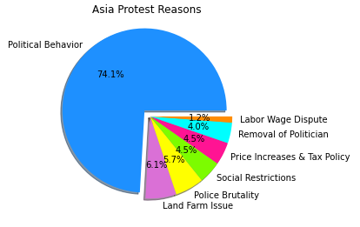
Protest analysis Protest Reason: What were the protest reasons? How does this differ between the regions?
Notes:
John

Slide 9

Happiness analysis
Sourced from Kaggle World Happiness Report
https://www.kaggle.com/mathurinache/world-happiness-report
Pulled 5 csv files of data and cleaned:
Removed unnecessary columns from each report
Moved and renamed columns within the data sets to match each other
Merged all 5 datasets into one file
Created “Total” columns to add up happiness scores and freedom scores
Notes:
Fereshteh

Slide 10
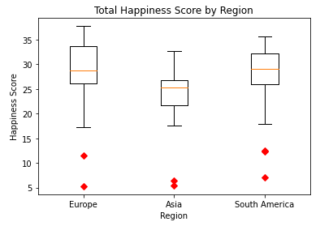
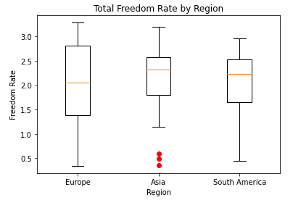
happiness analysis happiness score and freedom rate by regions
Notes:
Fereshteh

Slide 11
happiness analysis Happiness Score: Do the number/frequency of protests in a country affect how happy the country is?
Notes:
Fereshteh

Slide 12
Freedom analysis Freedom Score: Does a country's freedom score correlate with the amount of protests occurring?
Notes:
Fereshteh

Slide 13
conclusions
We found support for our first hypothesis and observed regional differences in the amount of protests and protest size.
Our second hypothesis was not supported as we did not find a significant relationship between a country’s number of protests and their happiness score or their freedom score.
We found significant differences in happiness scores on the regions analyzed.
We were surprised that we did not find any type of relationship between protest activity and happiness levels in the regions analyzed.
It was interesting to see the countries within these regions that had the largest amounts of protests.
For further analysis, we would like to look further at government trust/perception of corruption. This data is in some of our protest data sets. We’d like more clarity around what the numbers represent. Additional analysis around a country’s perception of government in relation to protests, and happiness scores would be an interesting follow up.
Cleaning the data was more difficult than originally thought.
Merging the data also proved challenging.
Notes:
Jen

Slide 14
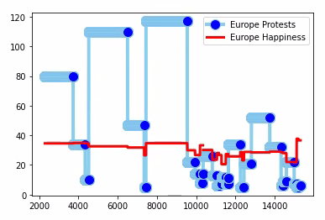
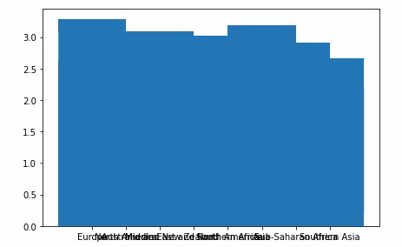

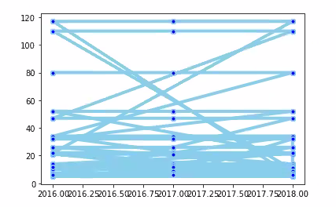
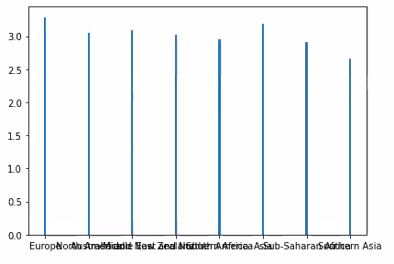
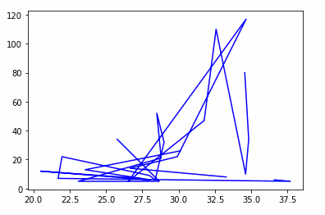
Open floor Q&A
Notes:
Jen

